Slide 1


Slide 2
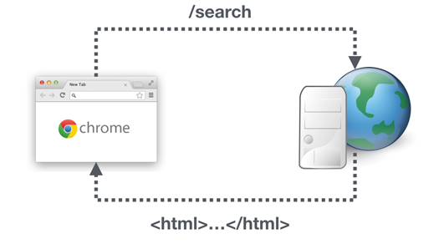
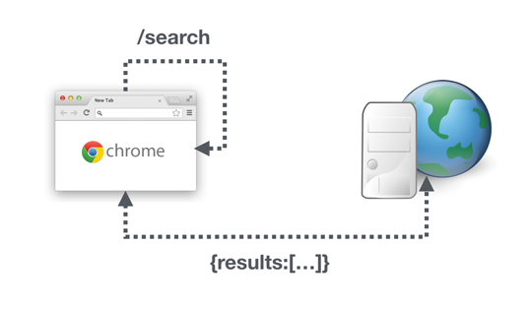
Multiple page
Multiple-page applications work in a “traditional” way. Every change eg. display the data or submit data back to server requests rendering a new page from the server in the browser.
Single Page
When we first navigate to a new site the server returns the html, javascript and css needed to render that page. All further changes to the URL are handled locally by the client application. Typically the client application will make one or more API requests to get the information it needs to show the new page.
Single page apps are distinguished by their ability to redraw any part of the UI without requiring a server round trip to retrieve HTML.

Slide 3
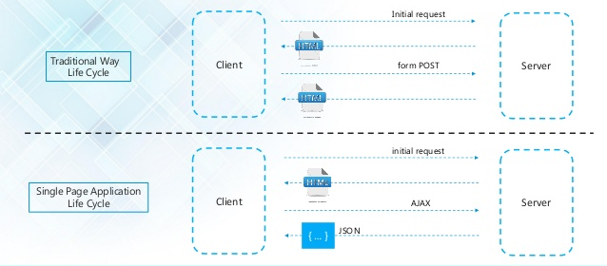

Slide 4
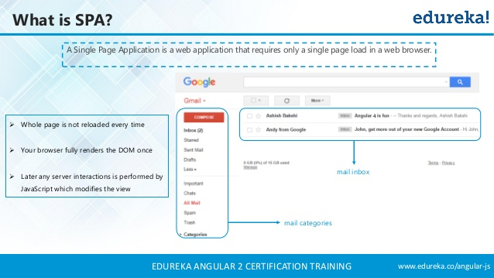

Slide 5
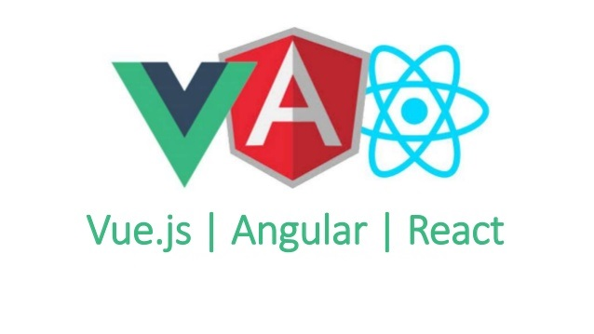

Slide 6
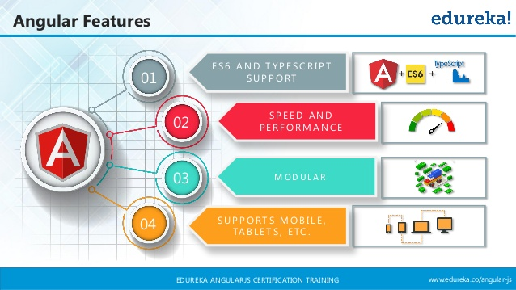

Slide 7
What Is Angular 6 or 7 or 8?
Angular is an framework written and maintained by angular team at Google and the Father of Angular is Misko Hevery.
Angular is an open source front-end framework created to make the process of building modern web apps, easier.
Angular framework is also utilized in the cross platform mobile development called IONIC, Titanium And PhoneGap and so it is not limited to web apps only.
Angular is written in TypeScript and so it comes with all the capabilities that typescript offers.
Angular comes with a number of features to address to see their business data with a rich UI.
Angular is designed to build applications using a number of code blocks separated into individual modules.

Slide 8
Difference Between Angular 7 or 8?
Angular 8 will be released with the features of IVY engine.
This release confirms that the new Angular version is much lighter, faster and easier.
Angular 8 supports the TypeScript 3.4 or above version.
In Angular 8, Google introduced another build tool called Bazel.
Changes in Lazy Loading syntax in Route
Bye Bye @angular/http
In Angular 8 it is mandatory to provide a Boolean static flag to define the instance of a ViewChild and ContentChild.
Ref : https://www.c-sharpcorner.com/article/angular-8-0-whats-new-and-how-to-upgrade/

Slide 9
Angular recommends the use of Microsoft’s TypeScript language, which introduces the following features:
Class-based Object Oriented Programming
Static Typing
TypeScript is a superset of ECMAScript 6 (ES6) That means whatever features we have in ES6 are also in TypeScript with some extra features on top, such as static typing and richer syntax and it is backward compatible with ECMAScript 5.
Angular also includes the benefits of ES6:
Iterators
For/Of loops
Reflection
Improved dependency injection
Dynamic loading
Asynchronous template compilation
Simpler Routing
Replacing controllers and $scope with components and directives
Support reactive programming using RxJS

Slide 10
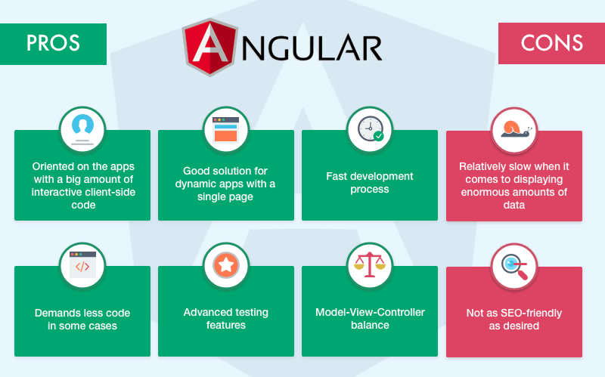

Slide 11
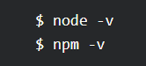
What Is Angular Prerequisites?
Before you can install Angular 7 or 8, you must need to have some prerequisites.
You must to have Node.js installed.
You must to have NPM (Node Package Manager) installed.
Noted Points -
We need to setup our machine’s local environments which are the following.
node.js >= Node LTS 10.16
npm >= 6.9.x
Visual Studio Code or Atom
Angular’s community has announced Angular releases in every 6 months and its looks like
Angular 6 is in Mar 2018 and
Angular 7 is in Oct 2018
Angular 8 is in May 2019
And so on

Slide 12
Project setup options for Angular apps :
There are a few different ways to get started with an Angular project.
By Webpack
By Angular-cli
Webpack is well-known tool and standard for creating Angular apps. By the use of webpack we can create project structure of angular applications from scratch and you know every aspect of the setup of angular application. If you want to know more about webpack installation for Angular apps refer this angular docs link https://angular.io/guide/webpack.
Angular CLI is mostly used tool for creating angular applications. It is a tool for the scaffold to create a new application which is based on angular. It helps in creating component, pipes, services, providers and prepare to build for deployment. Simplicity is the only reason for its popularity.

Slide 13
How To Create and Set Up a new Project in Angular using CLI?
First you must Install Node.js and npm if you are not already on your machine.
Steps 1 - install the Angular CLI globally.
npm install -g @angular/cli
Once installed, you can access the CLI tool by typing ng.
To check the version of your Angular CLI, type:
ng -v
Steps 2 - Create a new project
Open a Node.js command prompt
Generate a new project using the below command -
ng new my-app
Steps 3 - Serve the application
Go to your project directory using the Node.js command prompt and launch the angular server i.e.
cd my-app
ng serve –open
After run the above commands - automatically open your browser on http://localhost:4200/

Slide 14
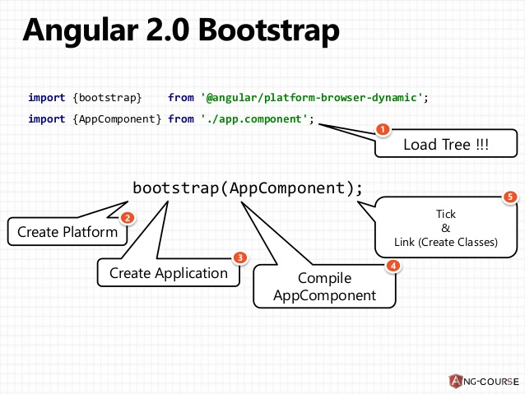
Angular Bootstrap
Required things to Bootstrap Angular Application :
1. NgModule : NgModule is most important in the Angular application. It is a class where all the parts of the angular application fit together. Every application has at-least one NgModule for bootstrapping the angular application.
2. Root Component : When angular CLI scaffold the new app of angular, root component automatically created whose name is app.component . This component includes 3 files above app.component.html , app.component.css , app.component.ts .
3. Browser Bootstrap : In the above 2 steps, we will gather the information about NgModule, imports array, declaration array, bootstrap array and default root component (app.component.ts) of the Angular project.
In this step, we learn about how to bootstrap module. In the process of bootstrapping of Angular applications, there are 3 main steps :
Import AppModule.
Import Browser Bootstrap.
Bootstrap the module.

Slide 15
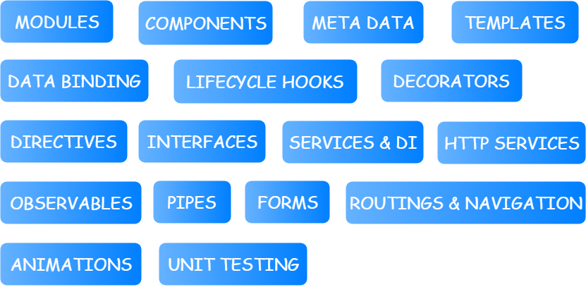

Slide 16
ANGULAR MODULE
1

Slide 17
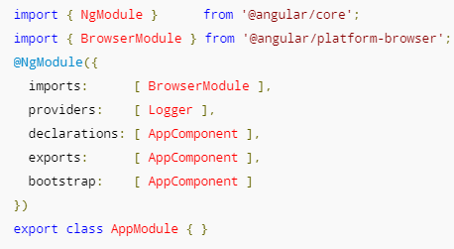
What is a Angular Module?
Another analogy to understand Angular modules is classes.
It is a mechanism to group components, directives, pipes and services that are related.
A module is a TypeScript class with the decorator NgModule applied on it.
Angular app contains at least one Angular module, i.e. the root module. Generally, it is named as AppModule. The root module can be the only module in a small application. While most of the apps have multiple modules.
Here we can see sample Every module.Where we have turned the class AppModule into an Angular module just by using the NgModule decorator.

Slide 18
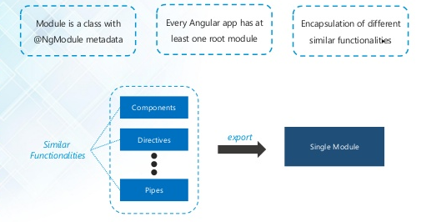

Slide 19
NgModule is a decorator function that takes a single metadata object whose properties describe the module. The most important properties are:
declarations - The view classes that belong to this module. Angular has three kinds of view classes: components, directives, and pipes.
exports - The subset of declarations that should be visible and usable in the component templates of other modules.
imports - Other modules whose exported classes are needed by component templates declared in this module.
providers - Creators of services that this module contributes to the global collection of services; they become accessible in all parts of the app.
bootstrap - The main application view, called the root component, that hosts all other app views. Only the root module should set this bootstrap property.

Slide 20
ANGULAR COMPONENT
2

Slide 21
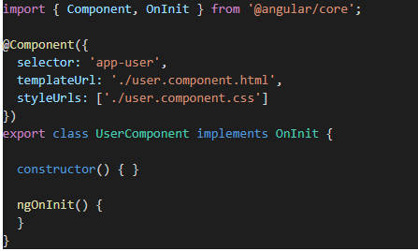
What is a Angular Component?
Components are anything that is visible to the end user
Components are the most basic building block of an UI in an Angular application.
Components can be reused many times within an application.
An Angular application is a tree of Angular components.
Angular components are a subset of directives. Unlike directives, components always have a template and only one component can be instantiated per an element in a template.
Here, first we import the components and dependencies that we require in our component using import keyword. Then, we attach the metadata of the component using @Component decorator.

Slide 22
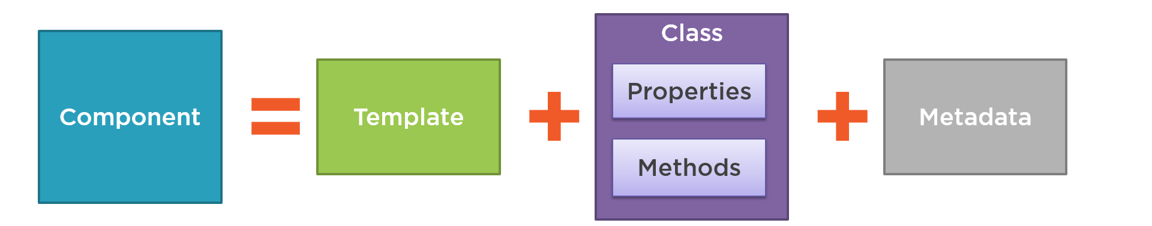
Components are a logical piece of code for Angular application. A Component consists of the following −
Template − This is used to render the view for the application. This contains the HTML that needs to be rendered in the application. This part also includes the binding and directives.
Class − This is like a class defined in any language such as C. This contains properties and methods. This has the code which is used to support the view. It is defined in TypeScript.
Metadata − This has the extra data defined for the Angular class. It is defined with a decorator.

Slide 23
ANGULAR METADATA
3

Slide 24
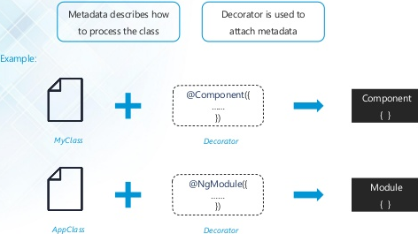

Slide 25
Metadata
Metadata tells Angular how to process a class.This is used to decorate Angular class with additional information.Metadata can be attached to TypeScript using a decorator.
Here is the @Component decorator, which identifies the class immediately below it as a component class. The @Component decorator takes the required configuration object which Angular needs to create and present the component and its view.
The most important configurations of @Component decorator are:
selector - css selector that identifies this component in a template
templateUrl - url to an external file containing a template for the view
providers - list of providers available to this component and its children

Slide 26
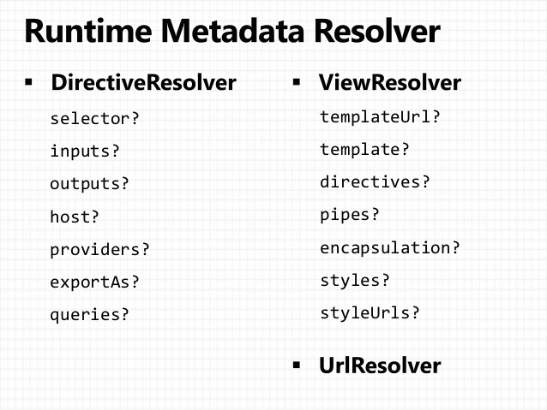

Slide 27
Directive Resolver
inputs - list of class property names to data-bind as component inputs
outputs - list of class property names that expose output events that others can subscribe to
host - map of class property to host element bindings for events, properties and attributes
selector - css selector that identifies this component in a template
queries - configure queries that can be injected into the component
exportAs - name under which the component instance is exported in a template
providers - list of providers available to this component and its children
View Resolver
styleUrls - list of urls to stylesheets to be applied to this component's view
styles - inline-defined styles to be applied to this component's view
template - inline-defined template for the view
templateUrl - url to an external file containing a template for the view
encapsulation - style encapsulation strategy used by this component

Slide 28
ANGULAR TEMPLATE
4

Slide 29
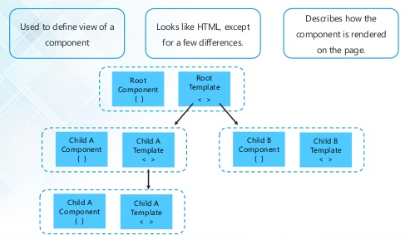

Slide 30
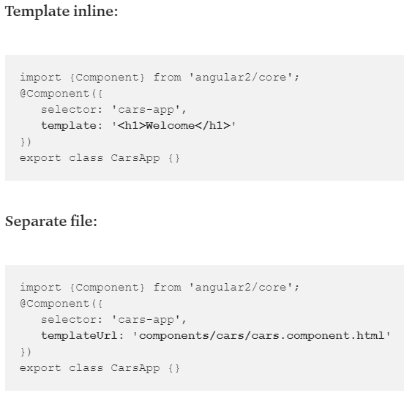
Template
Angular templating system gives us a syntax to express the dynamic part of our HTML.
A template is HTML that tells Angular how to render a component
Templates include data bindings as well as other components and directives
In Angular, a component needs to have a view. To define a view, you can define a template inline (using template) or in a separate file (using templateUrl).

Slide 31
To simplify things, a template helps us to render HTML with some dynamic parts depending on our data. It allows us to express data and property binding, event binding and templating concerns. To be able to express those behaviours,
Angular comes with its own symbols:
{{ }} for interpolation.
[] for property binding.
() for event binding.
# for variable declaration.
* for structural directives.

Slide 32
ANGULAR
DATA BINDING
5

Slide 33
DATA BINDING
Data binding is one of the most powerful features of software development technologies. Data binding is the connection bridge between View and the business logic (View Model) of the application. Data binding in Angular is the automatic synchronization between Model and the View. When the Model changes, the Views are automatically updated and vice-versa.
There are many ways to bind the data in Angular. Following are the types of data binding in Angular.
Interpolation
Property / One-way binding (unidirectional)
Two-way binding
Event binding

Slide 34
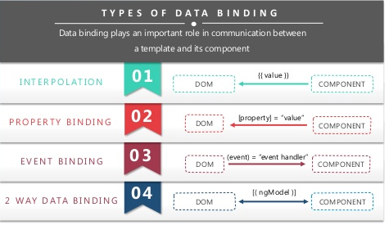

Slide 35




Interpolation: This is the easiest way of data binding in Angular. This is same as Expressions in Angular 1.x. In interpolation, we need to supply property name in the View template, enclosed in double curly braces, e.g. {{name}}. It is used for one-way binding (Component class to View only).
Property binding: Angular uses HTML DOM element property for one-way binding. The square brackets are used with property name for one-way data binding in Angular. For example, if we want one-way binding between Model property and template View for textbox, we need to use [value]. The following snippet shows a simple example of property binding:

Slide 36


Event Binding : Angular directly uses the valid HTML DOM element events. For example, ng-click is now replaced with (click). The round brackets (parentheses) are used with DOM event name for event binding in Angular.
Two-way Binding: It is a derived binding that uses both property binding and the event binding under the hood. This binding is used to display a value and also to update the value when a new value is entered in the UI. ngModel is a built-in directive that supports two-way binding. The following snippet shows how it is used:
<input type="text" [(ngModel)]="name" />
As you see, the two-way bound directive is enclosed inside [()] (called banana-in-a-box). This notation is again a mix of both property and event bindings. The parentheses around the event name indicate that it is data bound.

Slide 37

Two-way binding without ngModel directive :
Angular has a feature called "template reference variables". With this feature, we are able to have direct access to an element. The template reference variable is declared by preceding an identifier with a hash/pound character (#).
In the following example, we have declared a template reference variable named "txtName" on the input element. This variable is in reference to the input element. So, we can get the value property of the input element and display it with interpolation.

Slide 38
ANGULAR LIFECYCLE HOOKS
6

Slide 39
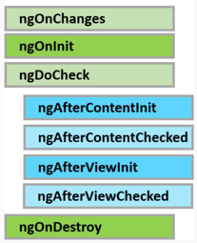
Component lifecycle hooks
A component has a lifecycle managed by Angular.
Creates the component
Renders the component
Creates and renders the component children
Checks when the component data-bound properties change, and
Destroys the component before removing it from the DOM
angular offers several lifecycle hooks as shown in the image
The 3 most commonly used hooks are
ngOnChanges : Executes, every time the value of an input property changes. The hook method receives a SimpleChanges object containing current and previous property values. This is called before ngOnInit
ngOnInit : Executes after the constructor and after ngOnChange hook for the first time. It is most commonly used for component initialisation and retrieving data from a database
ngOnDestroy : Executes just before angular destroys the component and generally used for performing cleanup

Slide 40
Other Lifecycle Hooks
ngDoCheck : This is for the detection and to act on changes that Angular can't or won't detect on its own.
ngAfterContentInit : This is called in response after Angular projects external content into the component's view.
ngAfterContentChecked : This is called in response after Angular checks the content projected into the component.
ngAfterViewInit : This is called in response after Angular initializes the component's views and child views.
ngAfterViewChecked : This is called in response after Angular checks the component's views and child views.

Slide 41
ANGULAR DECORATORS
7

Slide 42
What is a Angular Decorators?
Different types of decorators that Angular offers. There are four main types:
Class decorators : These are the top-level decorators that we use to express intent for classes. They allow us to tell Angular that a particular class is a component, or module
e.g. @Component and @NgModule
Property decorators : Those are properties inside classes, They allow us to decorate specific properties within our classes - an extremely powerful mechanism.
e.g. @Input and @Output
Method decorators : Those are methods inside classes, Method decorators are very similar to property decorators but are used for methods instead.
e.g. @HostListener
Parameter decorators : Those are parameters inside class constructors, An example of this is @Inject that lets us tell Angular what we want that parameter to be initiated with
e.g. @Inject

Slide 43
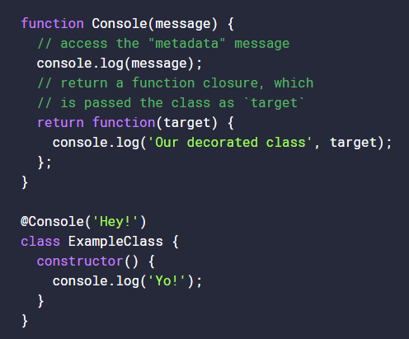
Custom decorator
Decorators are actually just functions, it’s as simple as that, and are called with whatever they are decorating. A method decorator will be called with the value of the method it’s decorating, and a class decorator will be called with the class to be decorated.

Slide 44
Angular 2 @Input and @Output
Input and Output are two decorators in Angular responsible for communication between two components.
@Input is a decorator to mark an input property and @Output is a decorator to mark an output property. @Input is used to define an input property to achieve component property binding. @Output is used to define output property to achieve custom event binding.@Input and @Output can define alias for property names as @Input(alias) and @Output(alias).

Slide 45
ANGULAR DIRECTIVE
8

Slide 46
DIRECTIVES
Directives are used to extend the HTML by creating custom HTML elements and extending the existing elements.
“Directives allow you to attach behavior to elements in the DOM”
Angular supports three types of directives.
Components—directives with a template.
Structural directives—change the DOM layout by adding and removing DOM elements.
Attribute directives—change the appearance or behavior of an element, component, or another directive.
Angular Directive is basically a class with a @Directive decorator. It has a selector metadata that defines the custom directive name. A @Component decorator is actually a @Directive decorator extended with template-oriented features. Whenever Angular renders a directive, it changes the DOM according to the instructions given by the directive. Directive appears within an element tag similar to attributes.

Slide 47
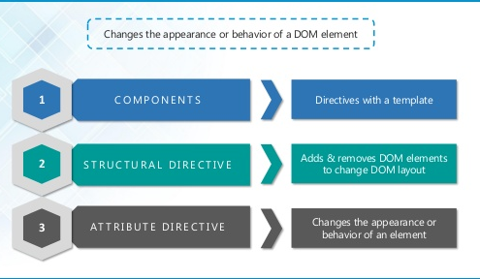

Slide 48
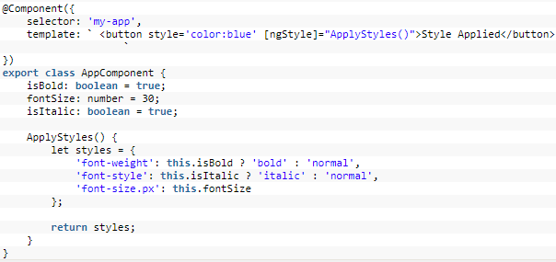
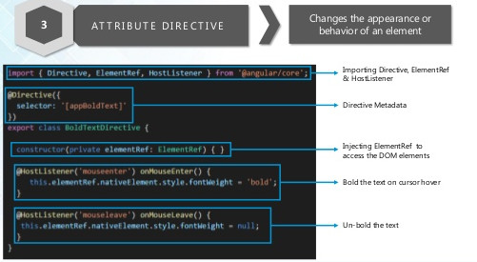
Attribute directive:
Attribute directive is mainly used to change/modify the behavior of the html element.As the name tells, it is used to change the attributes of the existing html element. In Angular there are many built in attribute directives. Some of the useful ones are NgClass, NgStyle

Slide 49
Custom Attribute Directives:
Angular custom attribute is created to change appearance and behavior of HTML element. Find the steps to create custom attribute directive.
1. Create a class decorated with @Directive().
2. Assign the attribute directive name using selector metadata of @Directive() decorator enclosed with bracket [] .
3. Use ElementRef class to access DOM to change host element appearance.
4. Use @Input() decorator to accept user input in our custom directive.
5. Use @HostListener() decorator to listen events in custom attribute directive.
6. Configure custom attribute directive class in application module in the declarations metadata of @NgModuledecorator.

Slide 50
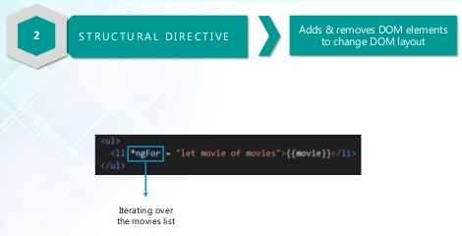
Structural Directives
Structural directives modify the template of the element. They can add, remove or replace elements inside the template. Like attribute directives, the structural directives are classes with the @Directive decorator. Usage of the structural directives differs from usage of attribute directives, they are prefixed with an asterisk in the HTML template.
<div *repeater="collection"></div>
<table *ngIf="data.length > 0">
<!-- HTML markup of table -->
</table>
Built-in structural directive - NgIf, NgFor, and NgSwitch

Slide 51
Custom Structural Directives
Structural directive is used to change the DOM layout by adding and removing DOM elements. Find the steps to create custom structural directive.
1. Create a class decorated with @Directive().
2. Assign the structural directive name using selector metadata of @Directive() decorator enclosed with bracket [] .
3. Create a setter method decorated with @Input(). We need to take care that the method name should be same as directive name.
4. Configure custom structural directive class in application module in the declarations metadata of @NgModuledecorator.
To create custom structural directive we need to use TemplateRef and ViewContainerRef etc that will help to change the DOM layout.
TemplateRef : It represents an embedded template that can be used to instantiate embedded views.
ViewContainerRef: It represents a container where one or more views can be attached.

Slide 52
ANGULAR
INTERFACES
9

Slide 53
Interfaces
Use interface keyword to create an interface
It is common to prefix the interface name with capital letter "I". However, some interfaces in Angular does not have the prefix "I". For example, OnInit interface
Interface members are public by default and does not require explicit access modifiers. It is a compile time error to include an explicit access modifier.
A class that implements an interface must provide implementation for all the interface members unless the members are marked as optional using the ?operator
Use the implements keyword to make a class implement an interface
TypeScript interfaces exist for developer convenience and are not used by Angular at runtime. During transpilation, no JavaScript code is generated for an interface. It is only used by Typescript for type checking during development.

Slide 54
ANGULAR
SERVICES
10

Slide 55
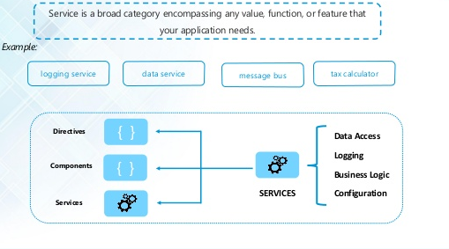

Slide 56

Service
A service is used when a common functionality needs to be provided to various modules.
A service in Angular is generally used to reuse data or logic across multiple components.
Angular services are injectable and injector can inject it in any component in our angular application. When we use @Injectable() decorator in service at class level then angular injector considers the service available to inject.
We use the @Injectable class decorators to automatically resolve and inject all the parameters of class constructor. We don’t need to use the @Injectable class decorator on classes which are already decorated with one of the other Angular decorators, such as @Component. That’s because the other decorators in Angular, such as @Component and @Directive, already perform the same function as @Injectable.

Slide 57


Dependency injection
It's a coding pattern in which a class receives its dependencies from an external source rather than creating them itself. In angular Injector injects the objects provided by provider into components and services. Only those classes which are configured by providers are available for dependency injection (DI).
DI provides these benefits
Create applications that are easy to write and maintain over time as the application evolves
Easy to share data and functionality as the angular injector provides a Singleton i.e a single instance of the service
Easy to write and maintain unit tests as the dependencies can be mocked
We register a service with the angular injector by using the providers property of @Component decorator or @NgModule decorator.

Slide 58
Angular provides different types of providers such as:
Class provider
Alias provider
Value provider
Factory provider
providers metadata has two parts.
1. Token: First part is token configured by provide attribute.
2. Provider Definition Object: Second part is provider definition object configured by useClass, useExisting, useValue. In case of useFactory, it is factory method that returns object, string, array etc for dependency injection.
Angular Injector Providers

Slide 59
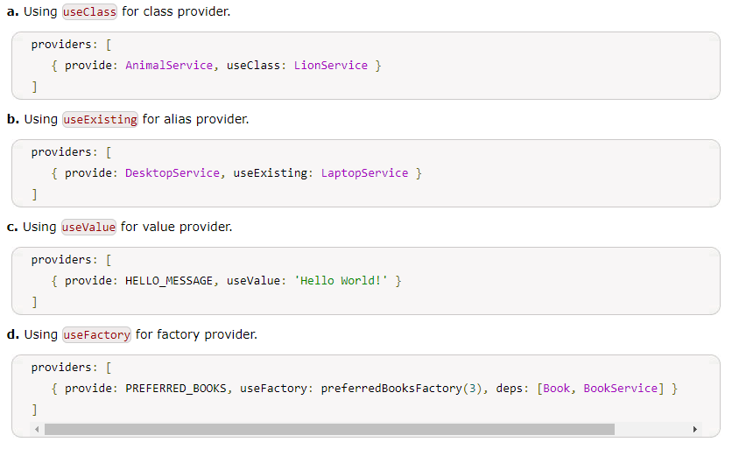

Slide 60
ANGULAR
HTTP SERVICES
11

Slide 61
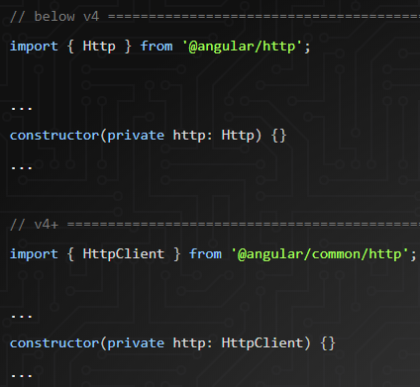
HTTP Services
Most front-end applications communicate with backend services over the HTTP protocol. The HttpClient in @angular/common/http offers a simplified client HTTP API for Angular applications that rests on the XMLHttpRequest interface exposed by browsers.
HttpClient has been introduced in Angular 4.3 version. HttpClient is smaller, easier and more powerful library for making HTTP requests. To use HttpClient we need to import HttpClientModule in our application module and then we can inject HttpClient in our components or services. HttpClient has methods such as get, post, delete, put, patch.

Slide 62
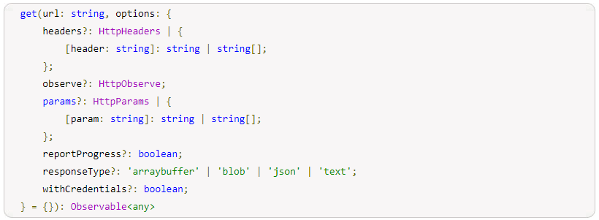
HttpClient.get
HttpClient serves the purpose to perform HTTP requests. HttpClient is injectable class. To perform http GET request, HttpClient provides HttpClient.get method that accepts URL and options for parameter, header etc and returns an Observable instance. When we subscribe Observable then GET request is executed on the server. Find the syntax of HttpClient.get from Angular doc.

Slide 63
We can see that HttpClient.get accepts URL and other options such as parameter, headers etc. HttpClient.get has following options to request http GET method.
headers: It is of HttpHeeaders typs. It sets headers for the http GET request.
observe: It defines whether we want complete response or body only or events only. We need to assign values for observe property such as response for complete response, body for response with body and events for response with events.
params: It is of HttpParams type. It sets parameters in URL for http GET request.
reportProgress: It is of boolean type. It is useful when we are requesting blob data. Setting reportProgress value as true we can know progress report for our HttpClient.get request.
responseType: It is used to define response type of HttpClient.get request. Its values can be arraybuffer, blob, json and text.
withCredentials: It is of boolean type. If the value is true then HttpClient.get will request data with credentials.
The response type of HttpClient.get is Observable i.e. provided by RxJS library. Observable is a representation of any set of values over any amount of time.

Slide 64

Promise
To perform asynchronous programming in Angular application we can use either Observable or Promise. When we send and receive data over HTTP, we need to deal it asynchronously because fetching data over HTTP may take time. Observable is subscribed by using async pipe or by using subscribe method.
A promise is a placeholder for a future value. It serves the same function as callbacks but has a nicer syntax and makes it easier to handle errors.
In Angular we can use either Promises or Observables. By default the Angular Http service returns an Observable. To use Promises instead of Observables we will have to first make a change to the service to return a Promise instead of an Observable. we are working with Promises in this example so lets convert it to a Promise with.

Slide 65
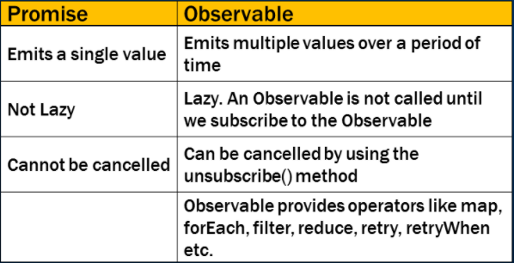
Angular promises vs observables
In Angular, to work with asynchronous data we can use either Promises or Observables.
There are several differences between Promises and Observables.

Slide 66
ANGULAR OBSERVABLES
12

Slide 67
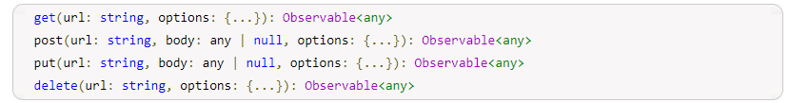
Observables
Observable is a class of RxJS library. RxJS is ReactiveX library for JavaScript that performs reactive programming. Observable represents any set of values over any amount of time. Observable plays most basic role in reactive programming with RxJS. Some methods of Observable class are subscribe, map, mergeMap, switchMap, exhaustMap, debounceTime, of, retry, catch, throw etc.
To use Observable in our Angular application, we need to import it as following.
Angular HttpClient and Observable
Angular HttpClient performs HTTP requests for the given URL. HttpClient works with Observable. Find some of its methods.

Slide 68

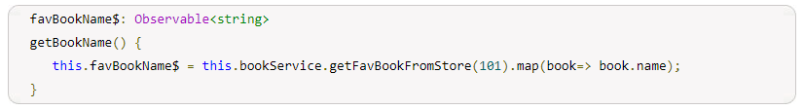
Observable subscribe
subscribe is used to invoke Observable to execute and then it emits the result. If we have an Observable variable that fetches data over an HTTP then actual hit to server takes place only when we subscribe to Observable using subscribe method or async pipe.
Observable map
map applies a given function to the value of its source Observable and then returns result as Observable.

Slide 69
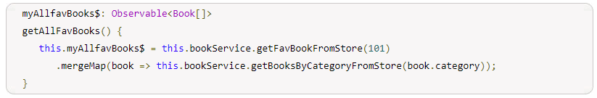

Observable mergeMap
mergeMap emits Observable based on the given function. If inner functions returns Observable then final output will be the result of inner Observable emitted data. If it gets multiple request before completing one, then mergeMap maps values by combining those multiple inner Observable into one by merging their emissions.
Observable of
of is a static method of Observable. of is used to create a simple Observable using data passed as argument.

Slide 70
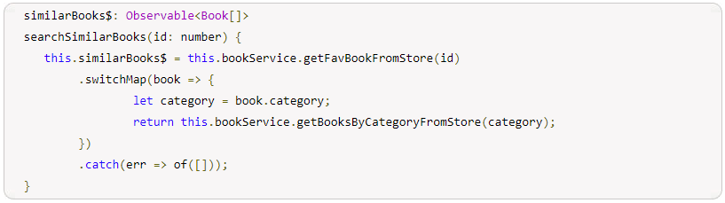
Observable switchMap
switchMap returns an Observable that emits data by applying the given function. If we have provided an inner Observable to our switchMap function then the final output will be emitted data by inner Observable. If switchMap receives multiple requests to execute inner Observable before completing the existing inner Observable, then it stops the existing execution and starts executing only the latest inner Observable execution request and keeps on doing so. The use case for switchMap could be search functionality where user keeps on changing search keyword before getting result and requires only result for latest search keyword.

Slide 71


Observable Error Handling
To handle error in Observable, it provides methods such as throw, catch, retry. The method throw can throw custom error. catch method caches the error thrown by Observable and then it can either return new Observablevalue or can throw custom error using throw. The method retry just retries executing Observable for the given number of times. To handle error in subscribe method, the second argument of subscribe caches the error.
Observable throw
throw creates an Observable that immediately emits error. throw is a static method of Observable. It is used to conditionally throw error from map, mergeMap, switchMap etc.
Observable catch
catch is a method of Observable class. catch method catches errors in the Observable to handle it by returning a new Observable or throwing an error. we can return any new value or can throw error

Slide 72
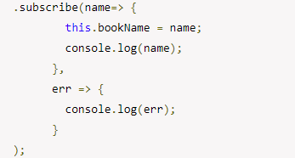

Observable subscribe Error Handling
In the subscribe method Second argument is to catch error. We can catch error in subscribe method as following
Observable retry
Some errors can be handled by just retrying request such as if errors are transient and unlikely to repeat. For example if we have slow network error and our request could not become successful then there are the chances to make request successful if request is retried. We can retry request automatically by using retry operator. It accepts number argument. Suppose we pass argument as retry(3) then the request will be retried for 3 times.

Slide 73
ANGULAR
PIPES
13

Slide 74
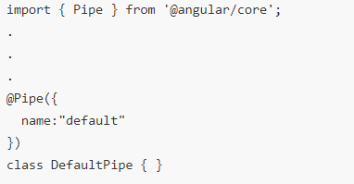
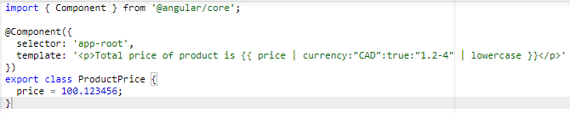
Pipes http://voidcanvas.com/angular-2-pipes-filters/
Angular provides a new way of filtering data. Pipes are a replacement for Angularjs filters.
Like a filter, a pipe also takes data as input and transforms it to the desired output. A basic example of using pipes is shown below
Passing Parameters : A pipe can accept optional parameters to modify the output. To pass parameters to a pipe, simply add a colon and the parameter value to the end of the pipe expression.
Chaining Pipes : We can chain pipes together to make use of multiple pipes in one expression.

Slide 75
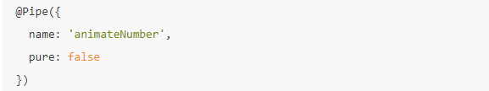
There are two categories of pipes:
Stateless pipes are pure functions that flow input data through without remembering anything or causing detectable side-effects. Most pipes are stateless. The Currency Pipe we used and the length pipe we created are examples of a stateless pipe.
Stateful pipes are those which can manage the state of the data they transform. A pipe that creates an HTTP request, stores the response and displays the output, is a stateful pipe. Stateful Pipes should be used cautiously. Angular provides AsyncPipe, which is stateful.
Pipes are stateless by default. We must declare a pipe to be stateful by setting the pure property of the @Pipe decorator to false.

Slide 76
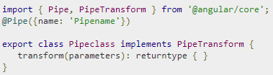
Custom Pipes
Angular also has the facility to create custom pipes. To create a pipe we use the @Pipe decorator.
Pipename − This is the name of the pipe.
Pipeclass − This is name of the class assigned to the custom pipe.
Transform − This is the function to work with the pipe.
Parameters − This are the parameters which are passed to the pipe.
Returntype − This is the return type of the pipe.

Slide 77
ANGULAR
FORMS
14

Slide 78
FORMS
Angular is much more flexible than Angular 1.x for handling forms — we are no longer restricted to relying solely on ngModel. Instead, we are given degrees of simplicity and power, depending on the form's purpose.
Template-Driven Forms places most of the form handling logic within that form's template
Reactive Forms places form handling logic within a component's class properties and provides interaction through observables
We need to bootstrap our application using the FormsModule or ReactiveFormsModule
Below are the things that a form library should cover :
Support two-way binding so that the input control values are in sync with the component state.
Keep track of the form state and use visual cues to let the user know whether the current state is valid or not. For instance, if the username has invalid characters, a red border should appear around the input field for the username.
Have a mechanism to display validation errors properly.
Enable or disable certain parts of the form unless some validation criteria are met.

Slide 79
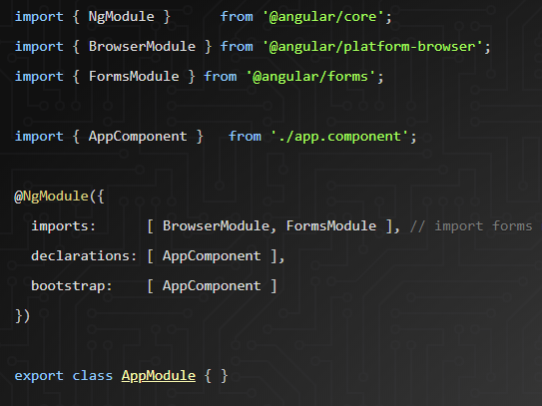
Template-Driven Forms
The template-driven approach is a strategy that was borrowed from the AngularJS era. In this, it is the most straightforward method for building forms by taking advantage of the directives. Template-Driven forms uses directives such as ngModel, ngModelGroup, and ngForm to supercharge the form elements.

Slide 80
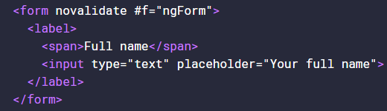
Binding ngForm and ngModel
ngForm and ngModel are Angular directives that are essential to creating template-driven forms.
NGFrom : In this <form> we are exporting the ngForm value to a public #f variable, to which we can render out the value and validation of the form
NgModel : It has three different syntaxes to tackle this situation. They are:
[(ngModel)] : performs two-way binding for reading and writing input control values. The input field takes an initial value from the bound component class and updates it back whenever any change to the input control value is detected.
[ngModel] : performs one-way binding, Here the data flows from the model to the view.
ngModel : The value of the name attribute will become a key of the ngForm reference object

Slide 81
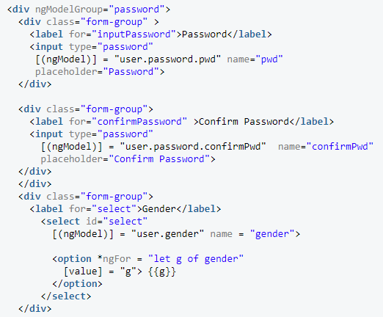
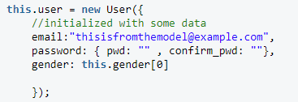
ngModelGroup
ngModelGroup directive to arrive at a cleaner implementation, while Angular does the heavy lifting of converting form-fields into nested data.
It is used to group together similar form fields so that we can run validations only on those form fields. Since both the password fields are related, we will put them under a single ngModelGroup.
+

Slide 82
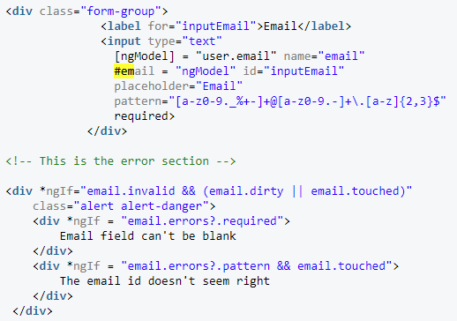
Validation and Displaying Error Messages
We have the following popular validators in Angular:
required
minlength
maxlength
pattern
The first one is easy. You have to add a required validation attribute to each form element like shown in snippet.
Apart from the required attribute, I've also exported a new #email template reference variable. This is so that you can access the input box's Angular control from within the template itself. We will use it to display errors and warnings.
Remember the #email variable that we exported earlier? It carries some amount of information about the input control state of the email field. This includes: email.valid, email.invalid, email.dirty, email.pristine, email.touched, email.untouched, and email.errors.
email.errors to check all possible validation errors and then display them back to the user in the form of custom messages

Slide 83

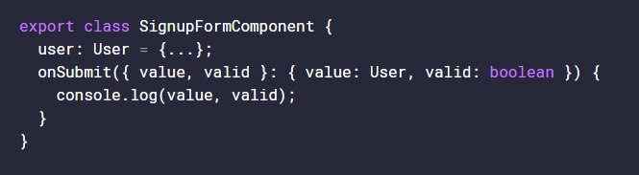
Submit the Form Using ngSubmit
To submit Form, all we need to do is add a ngSubmit event directive to our form
Here we’re using Object destructuring to fetch the value and valid properties from that #f reference we exported and passed into onSubmit. The value is basically everything we saw from above when we parsed out the f.value in the DOM. That’s literally it, you’re free to pass values to your backend API.

Slide 84
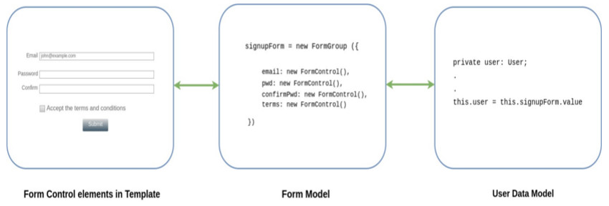
Reactive forms
Reactive forms take a different approach compared to that of the template-driven forms. Here, we create and initialize the form control objects in our component class. They are intermediate objects that hold the state of the form. We will then bind them to the form control elements in the template.
The form control object listens to any change in the input control values, and they are immediately reflected in the object's state. Since the component has direct access to the data model structure, all changes can be synchronized between the data model, the form control object, and the input control values.

Slide 85
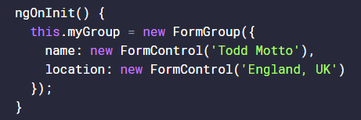

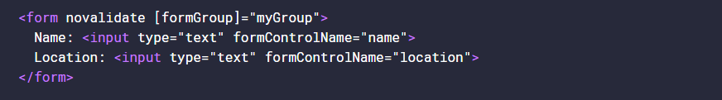
Basic Form Setup:
To create a Reactive form, you need to import the ReactiveFormsModule from @angular/forms
FormControl and FormGroup
FormControl is a class that powers an individual form control, tracks the value and validation status, whilst offering a wide set of public API methods.
FormGroup is a group of FormControl instances, also keeps track of the value and validation status for the said group, also offers public APIs.

Slide 86
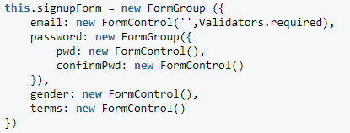
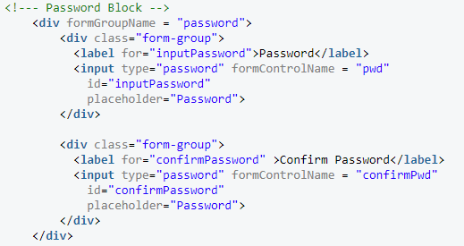
Nested FormGroup :
formGroupName = "password" performs the binding for the nested FormGroup

Slide 87


Validating the Form

Slide 88


FormBuilder
Angular provides you with a syntax sugar for creating new instances of FormGroup and FormControl called FormBuilder. The FormBuilder API doesn't do anything special other than what we've covered here.
It simplifies our code and makes the process of building a form easy on the eyes.

Slide 89



ngSubmit
Here we’re using Object destructuring to fetch the value and valid properties from the user reference we pass into onSubmit. The value is the same reference as printing user.value out in the DOM. That’s literally it, you’re free to pass values to your backend API.
Now, for the more internal approach. Because this.user is technically our model, we can simply reference the model onSubmit internally, and not pass user through as a function argument:

Slide 90
ANGULAR ROUTING & NAVIGATION
15

Slide 91
Routing & Navigation
Routing allows us to express some aspects of the application's state in the URL.
Routing allows you to:
Maintain the state of the application
Implement modular applications
Implement the application based on the roles (certain roles have access to certain URLs)
The Angular Router its own library package, @angular/router. Import what you need from it as you would from any other Angular package.
RouterModule :
RouterModule.forRoot takes the Routes array as an argument and returns a configured router module.

Slide 92


Route Definition Object :
The Routes type is an array of routes that defines the routing for the application. Each route can have different attributes, some of the common attributes are:
path - URL to be shown in the browser when application is on the specific route
component - component to be rendered when the application is on the specific route
redirectTo - redirect route if needed; each route can have either component or redirect attribute.
pathMatch - optional property that defaults to 'prefix'; determines whether to match full URLs or just the beginning. When defining a route with empty path string set pathMatch to 'full', otherwise it will match all paths.
children - array of route definitions objects representing the child routes of this route

Slide 93

Router outlet :
<router-outlet></router-outlet> is the placeholder to render the component based on which option the user chooses.
Router links :
Add links to routes using the RouterLink directive.
Error Route :
** is for any route which does not fit the default route.

Slide 94


Child Routes :
When some routes may only be accessible and viewed within other routes it may be appropriate to create them as child routes.
Router events :
Once you have a reference to the Router for your application you can subscribe to its “events” observable. This observable will emit a route-event whenever applicable that you can listen for. Being an observable you can subscribe to it in multiple places, filter for the specific event you want, transform the raw event, or anything else you could do with an observable.

Slide 95
Router Guards
We take a look at a few of the different types of guards and how to implement them for specific use cases.
CanActivate : Checks to see if a user can visit a route.
CanActivateChild : Checks to see if a user can visit a routes children.
CanDeactivate : Checks to see if a user can exit a route.
Resolve: Performs route data retrieval before route activation.
CanLoad : Checks to see if a user can route to a module that lazy loaded.

Slide 96
RouterState and RouterStateSnapshot:
RouteStateSnapshot is an immutable data structure representing the state of the router at a particular moment in time. Any time a component is added or removed or parameter is updated, a new snapshot is created.
RouterState is similar to RouteStateSnapshot, except that it represents the state of the router changing over time (Or) router state is an arrangement of application components that defines what is visible on the screen.

Slide 97
https://www.edureka.co/blog/angular-tutorial/
https://www.concretepage.com/angular-2/
https://reqres.in/
https://sergeome.com/blog/2017/11/26/simply-about-new-httpclient-in-angular/
http://csharp-video-tutorials.blogspot.in/2017/06/angular-2-tutorial-for-beginners_12.html

Slide 98
Questions
Typescript vs Javascript vs ES6
https://www.freecodecamp.org/news/48-answers-on-stack-overflow-to-the-most-popular-angular-questions-52f9eb430ab0/
https://www.edureka.co/blog/interview-questions/top-angularjs-interview-questions-2016/
https://github.com/sudheerj/angular-interview-questions

Slide 99
https://www.youtube.com/watch?v=I317BhehZKM
https://www.youtube.com/watch?v=PhggNGsSQyg
https://codecraft.tv/courses/angular/http/http-with-observables/

